Slide 1

PROJECT
Real-Time Analytics
Dashboard
SUBMITTED BY: PRADIP BOCAHRE

Slide 2

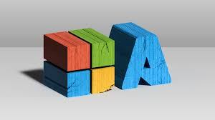
PROJECT
STATEMENT
Build a real-time analytics dashboard using Azure Synapse Analytics for data storage, Azure Databricks for real-time analytics, and Azure Data factory for orchestrating the data.

Slide 3
Project Overview
Welcome to the Tokyo-Olympics Data Engineering project on Azure! This project is designed to showcase how various Azure services can be utilized to ingest, store, transform, and analyse Olympics-related data. Starting with a CSV on GitHub, the data is ingested into the Azure ecosystem via Azure Data Factory. It's initially stored in Azure Data Lake Storage Gen2, then transformed in Azure Databricks. The enriched data, once again housed in ADLS Gen2, undergoes advanced analytics in Azure Synapse. The insights are finally visualized Power BI, offering a comprehensive view of the dataset.

Slide 4

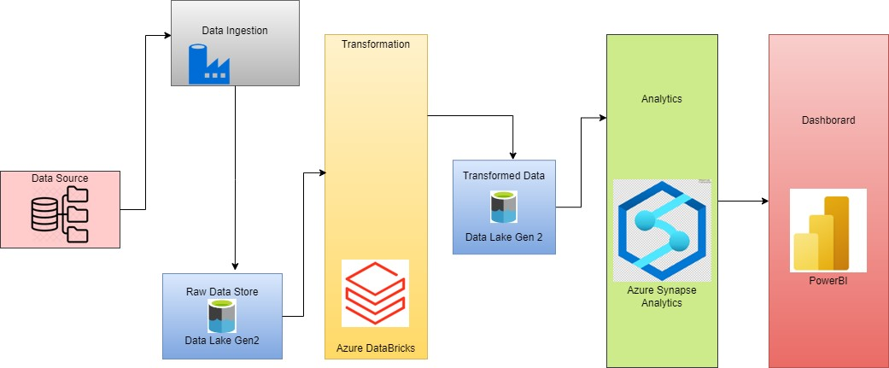



Process Flow
Architectural Diagram
End to End pipeline architecture in azure

Slide 5





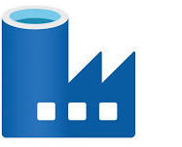
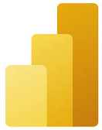
Azure Resource Used
Azure Data Lake Storage Gen2
Azure Synapse Analytics
Azure Databricks
Azure Data Factory
PowerBI

Slide 6

Project Requirement
Power BI: Power BI will be used to create interactive dashboards
Azure Data Lake Storage Gen2 (ADLS Gen2): ADLS Gen2 will serve as the central data repository for storing raw and processed data in a scalable and secure manner.
Azure Synapse Analytics: Azure Synapse Analytics will be used for data processing, including data transformation, aggregation, and analysis to derive insights from the stored data.
Azure Databricks: Azure Databricks will enable real-time analytics processing by providing a scalable and collaborative environment for running Spark-based analytics jobs.
Azure Data Factory: Azure Data Factory will orchestrate data pipelines, facilitating the extraction, transformation, and loading of data from various sources into ADLS Gen2 and Azure Synapse Analytics.

Slide 7






Implementation
1)Azure Environment Setup
2)Data Ingestion with Data Factory
3)Transform data with Azure Databricks
4)Data store and management with ADLS gen2
5)Dashboard development with PowerBI

Slide 8
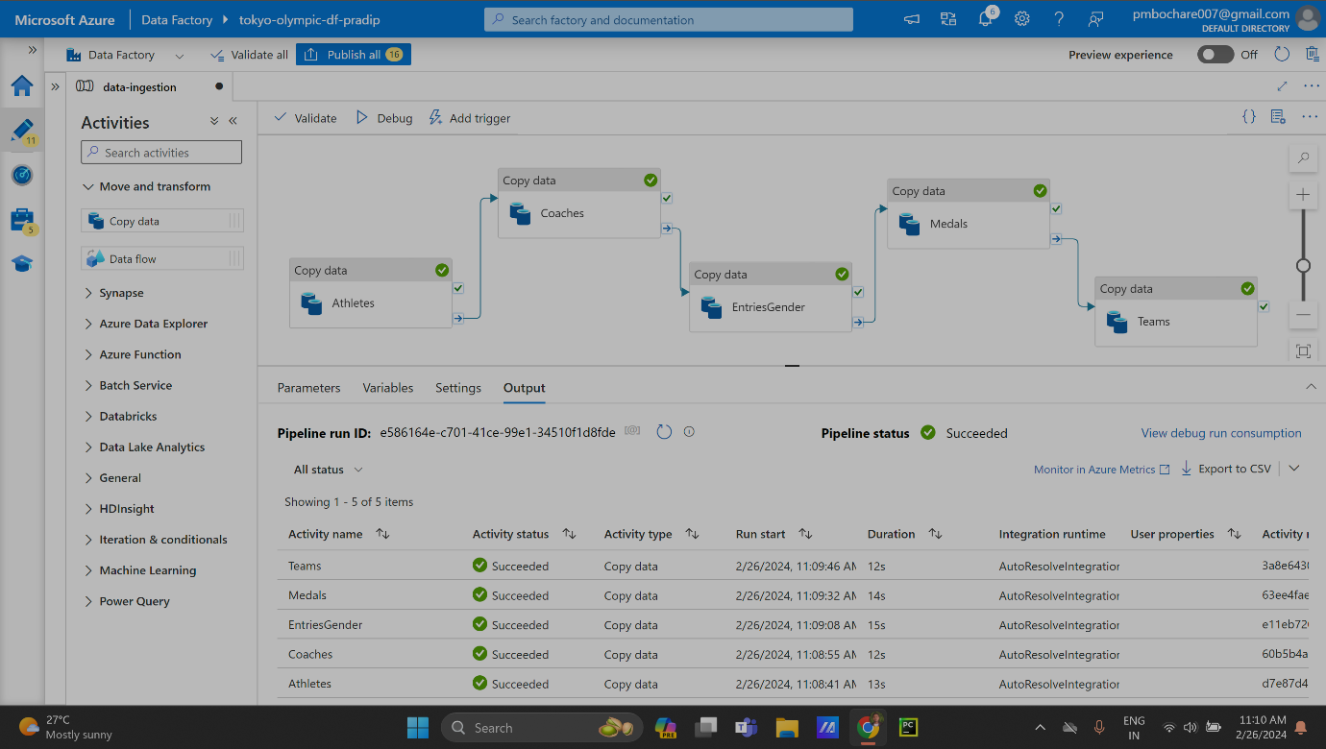
Implementation
The execution process for building a real-time analytics dashboard using ADLS Gen2, Azure Synapse Analytics, Azure Databricks, Azure Data Factory, and Power BI:
1)AZURE SETUP ENVIRONMENT
2)DATA INGESTION WITH DATA FACTORY

Slide 9
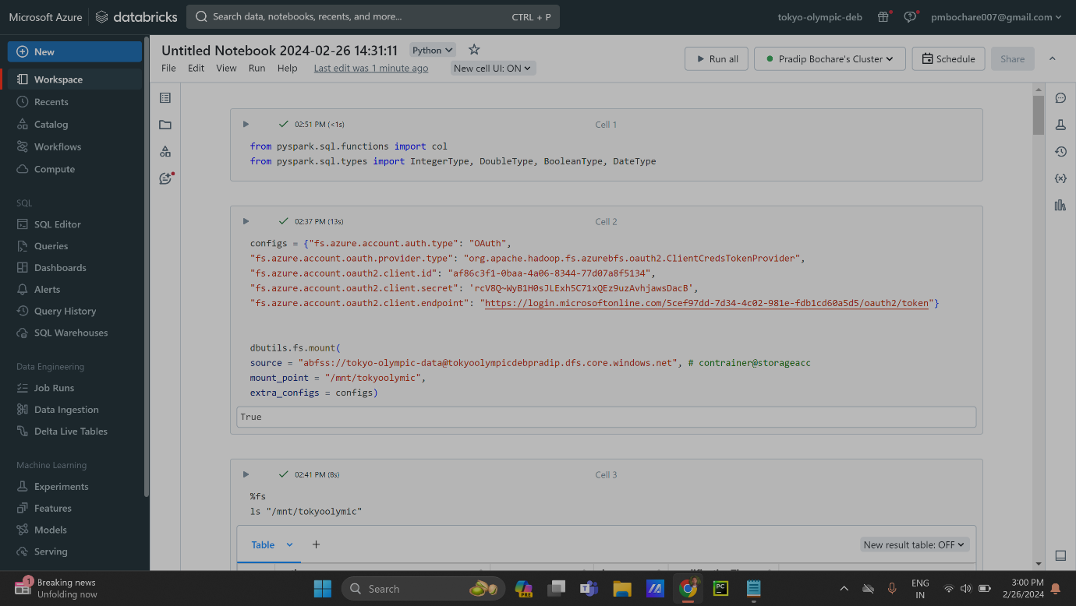
Implementation
3)TRANFORM DATA WITH AZURE DATABRICKS:Develop real-time analytics solutions using Azure Databricks to process data streams and derive insights. Implement data transformations, aggregations, and machine learning algorithms for analytics

Slide 10
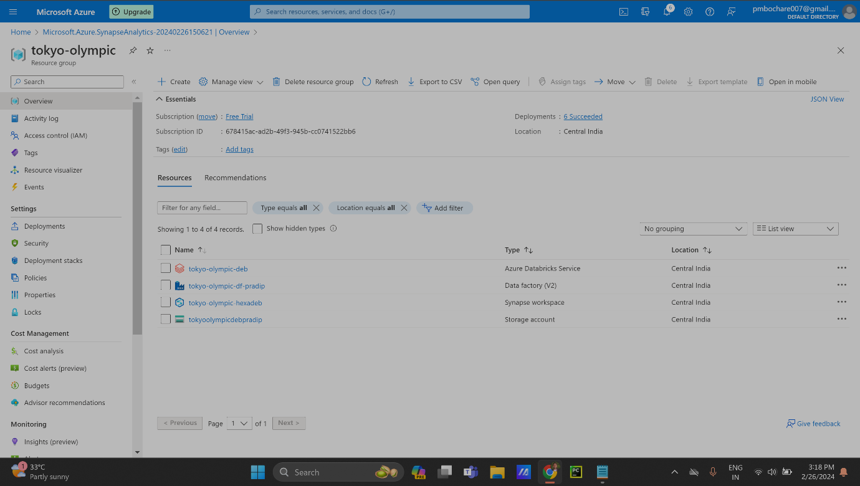
Implementation
4)Data Store and Management:Optimize data storage structures and configurations in ADLS Gen2 and Azure Synapse Analytics. Implement partitioning, indexing, and compression techniques for efficient storage and querying

Slide 11
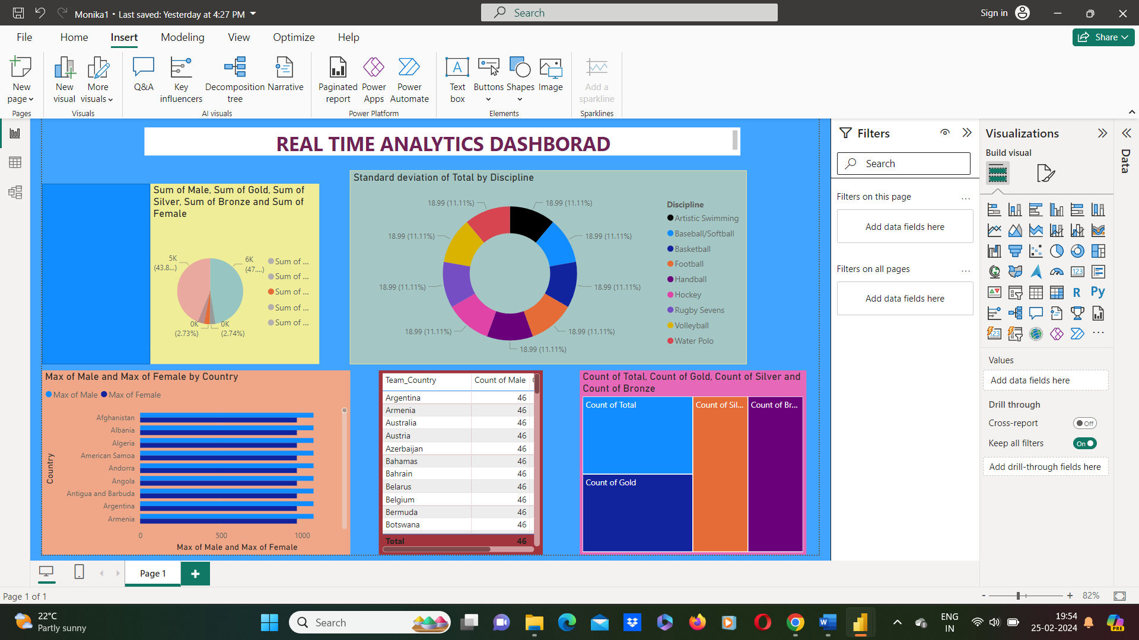
Implementation
5)Dashboard Development with PowerBI:Connect Power BI to Azure Synapse Analytics, ADLS Gen2, and other data sources. Design interactive dashboards with Power BI's visualization tools.

Slide 12

TECHNOLOGIES USED
pySpark
Azure Data Lake Gen2
Azure Databricks
Azure Data Factory
Azure Synapse Analytics
PowerBI

Slide 13
CONCLUSION
The conclusion of the project to build a real-time analytics is the project successfully achieved its objectives of creating a real-time analytics dashboard that provides insights into data stored in ADLS Gen2 and Azure Synapse Analytics.

Slide 14
Thank you

